Slide 1

EL CAMINO REELERS
GENERAL MEETING
TUESDAY, FEBRUARY 17, 2026

Slide 2
Agenda
2025 in Review (Michael)
Membership & Financial Summary (Ed)
Board Elections & ways to help (Mike)
Coming in 2026 (Pete)
Acknowledgments (Mike)
Notes:
Who’s going to present what?

Slide 3
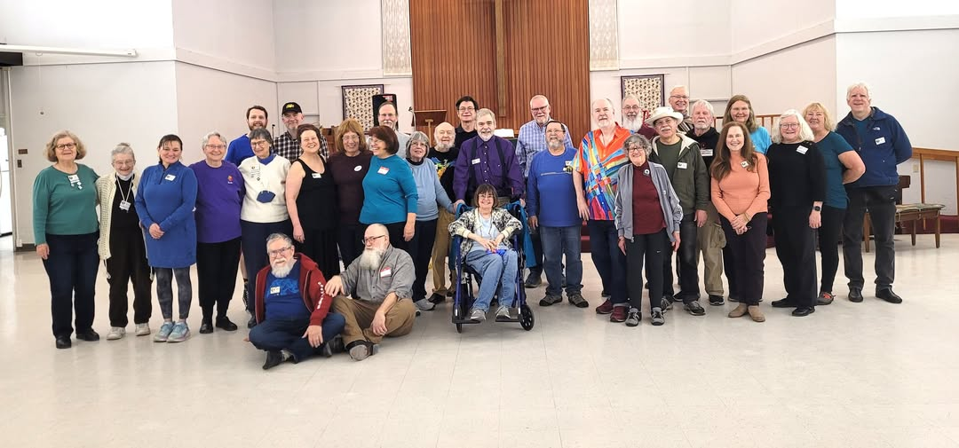
2025 in Review
What did we do last year?
At the “Hot Dish” potluck, Jan. 3

Slide 4
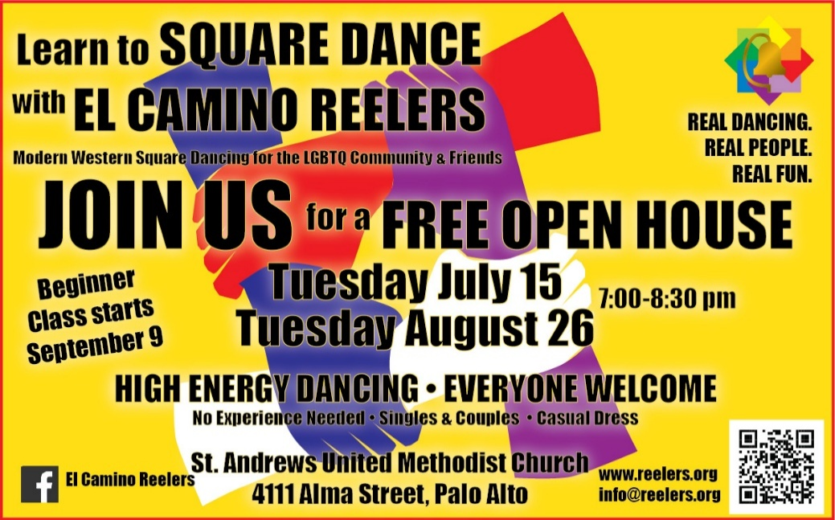
Growing the club
Growing our membership was priority #1
  Open House nights in April, July and August
  Recruiting at Pride events
  SSD-to-Plus Blast Class: (follow-on to last year’s beginner class)
  “Indigo” Beginner class: September-December
  Focus on class level dancing on Tuesday
  club nights

Slide 5

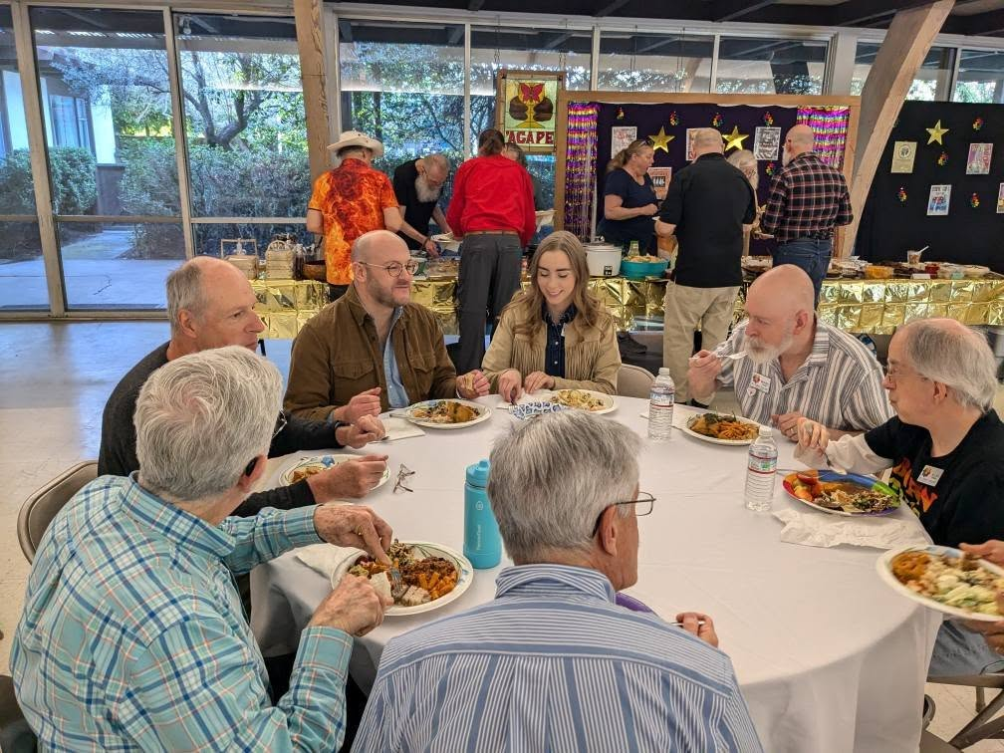
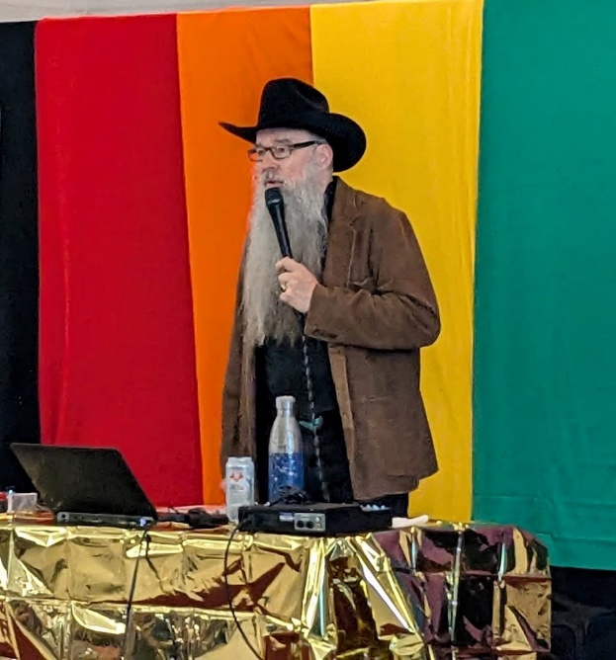
March 22: Remake the Circle
We celebrated our 40th Anniversary with a potluck and dance featuring caller Michael Kellogg

Slide 6

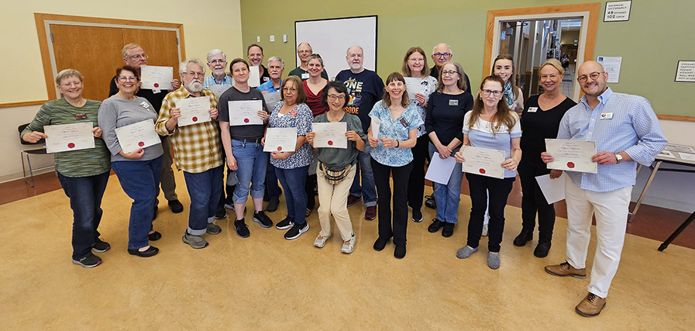
SSD-to-Plus Class
A joint “Blast Class” with Oaktown 8’s attracted dancers from clubs around the Bay Area

Slide 7

May 3: Walk & Dodge into Spring
Toronto’s Barry Clasper calls our Spring dance
BARRY
ON
BOARD

Slide 8
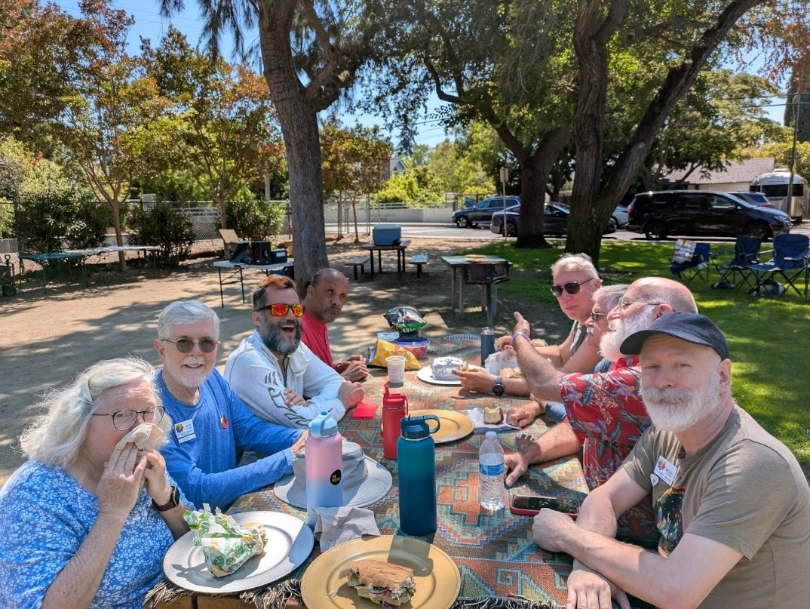
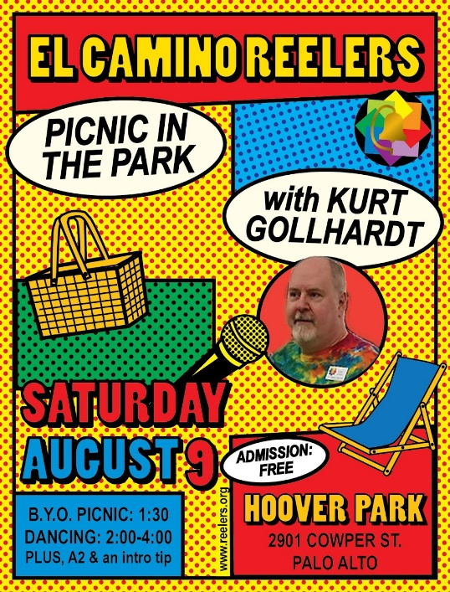
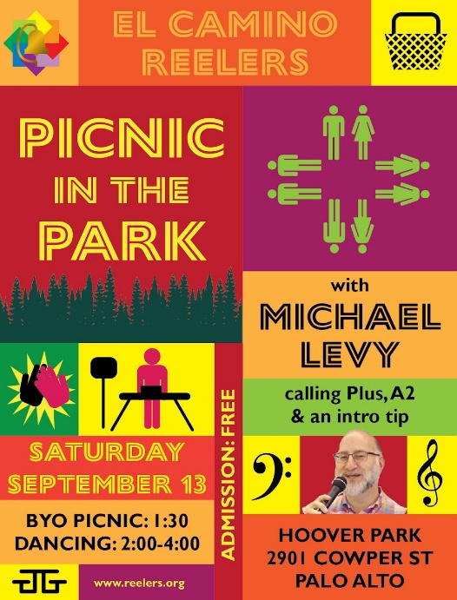
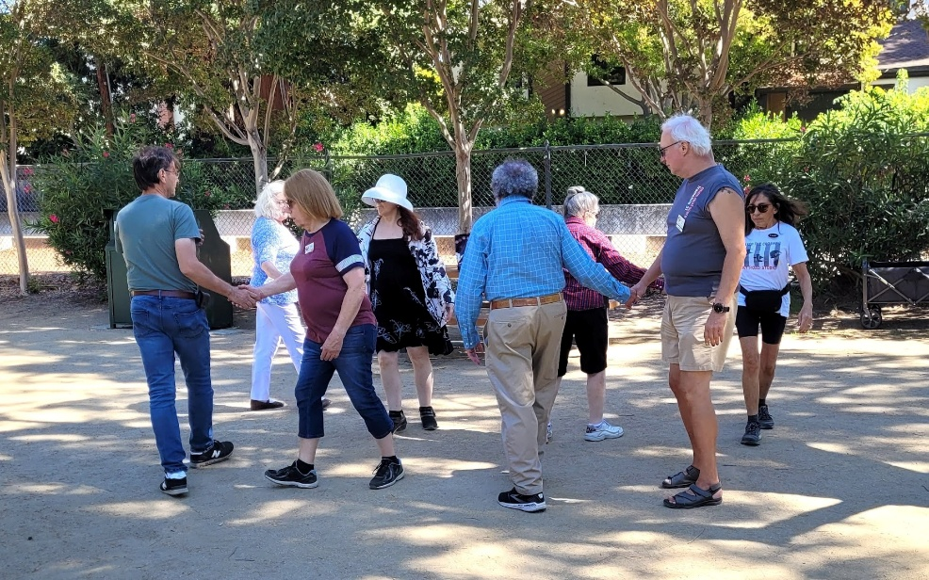

Three Picnics in the Park

Slide 9
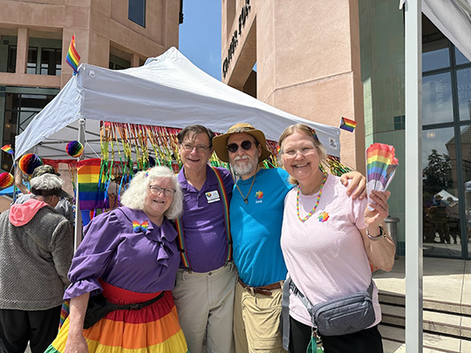
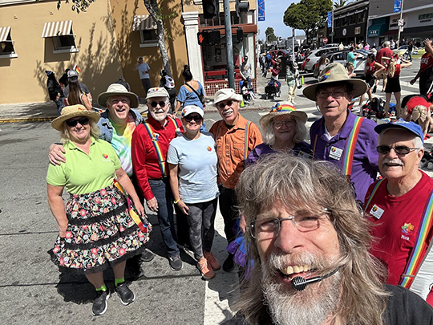
Two Pride events in June
Staffed a booth and performed at San Mateo County Pride (our 13th) and Mountain View Pride (their first)

Slide 10
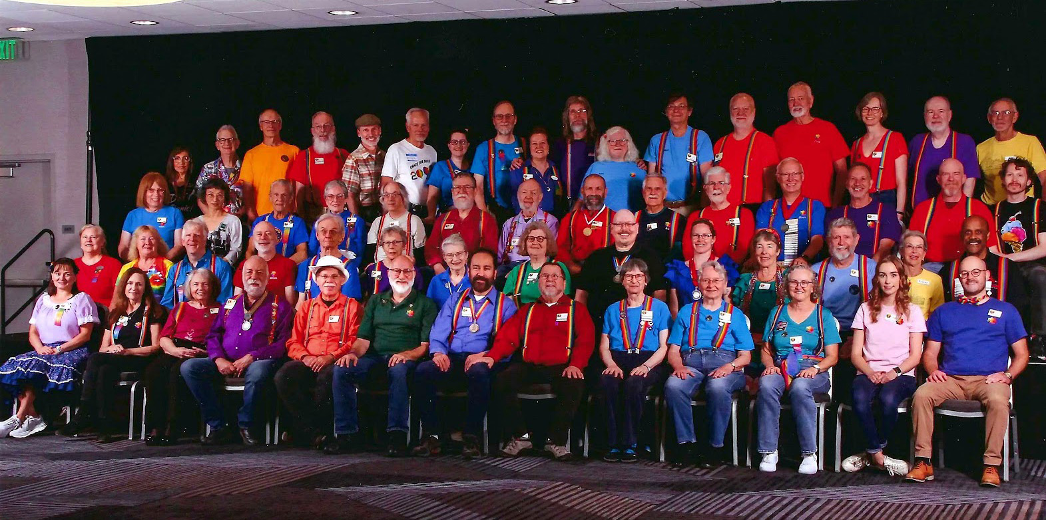
July: Hitch-Hiking the Galaxy
at the 42nd IAGSDC Convention in San Francisco

Slide 11

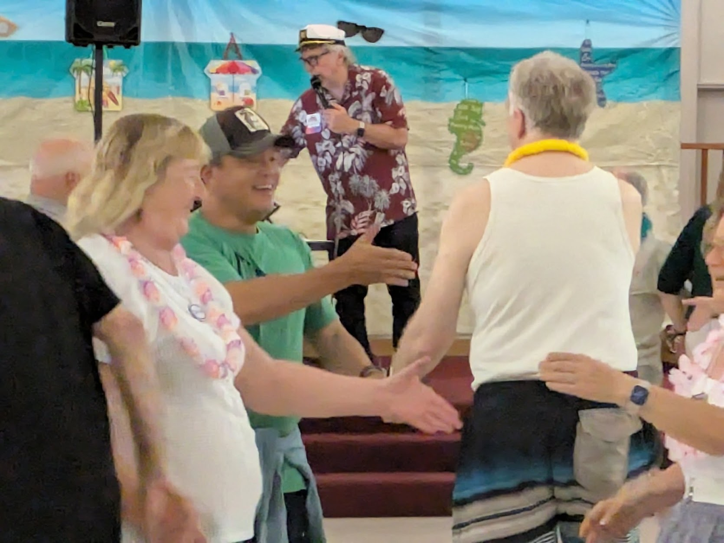
Aug. 23: DIVE THRU
Aaah-Ooo-Gaaahh!
Our nautical-themed summer dance with caller Darren Gallina

Slide 12



Three Friday Potlucks

Slide 13
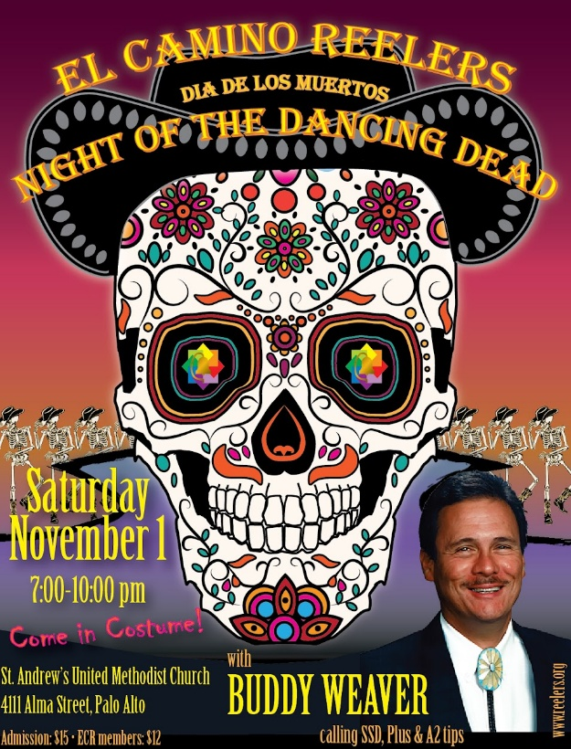
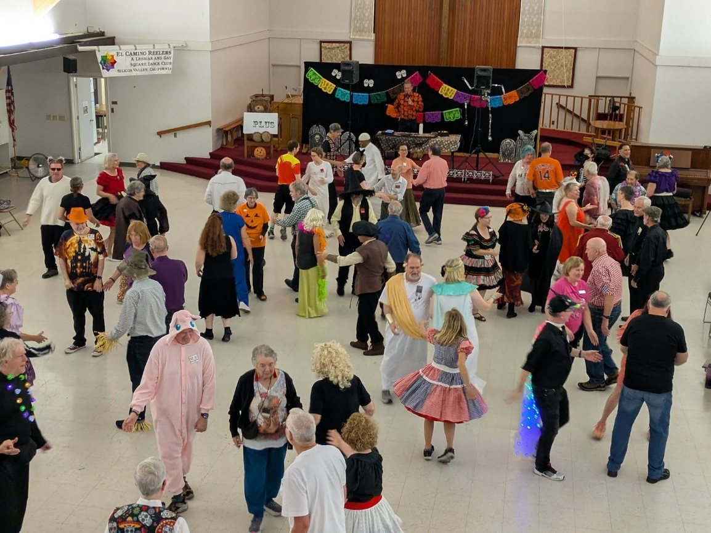
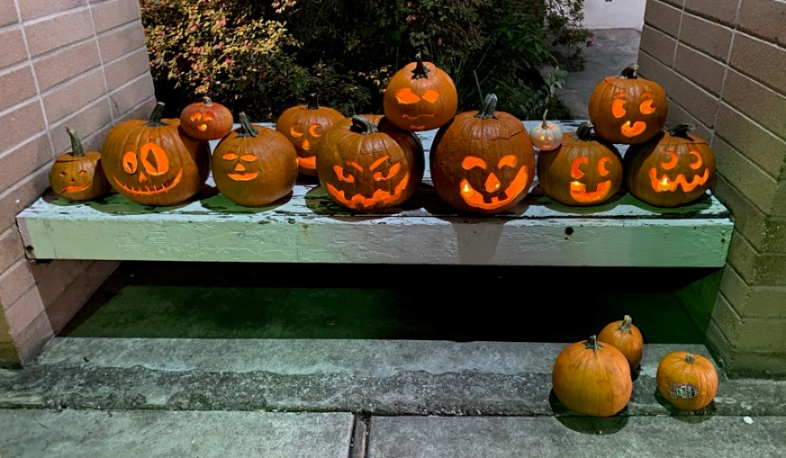
Nov. 1: Night of the Dancing Dead
Big crowd, great costumes, and fun dancing with caller Buddy Weaver
And… Great Pumpkins!

Slide 14
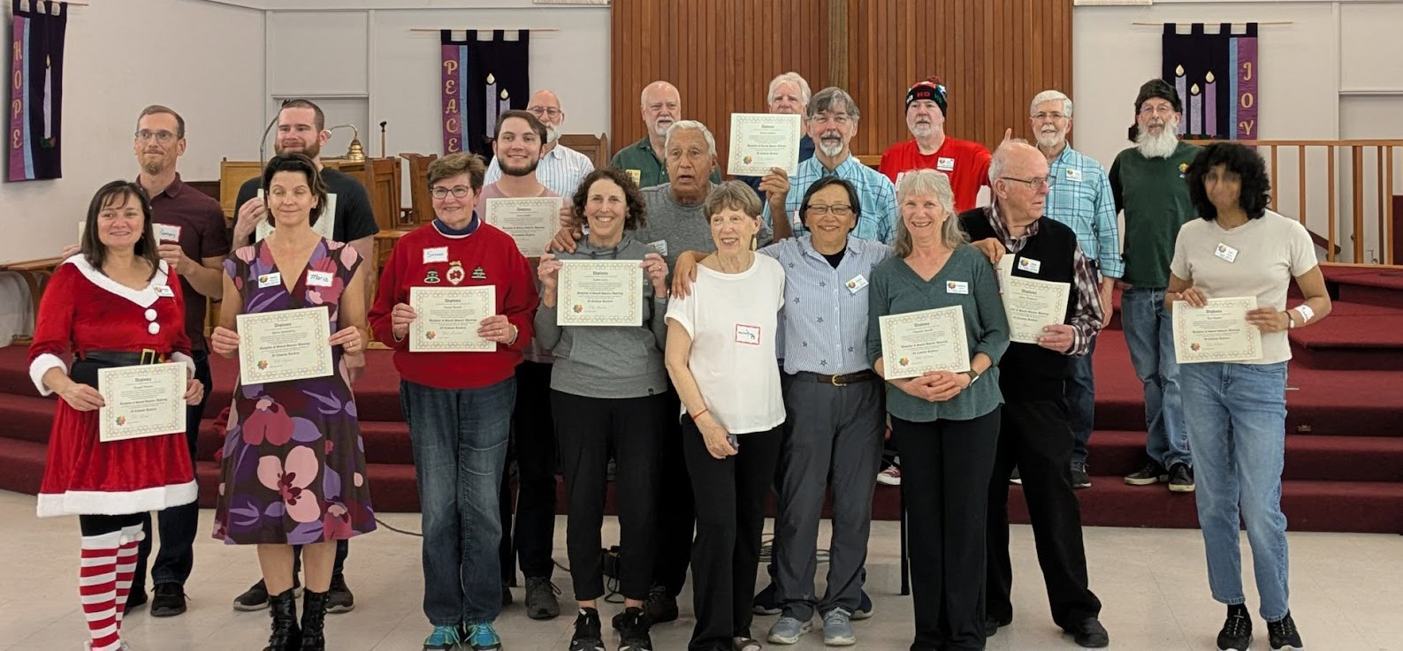

Fall SSD class
Dec. 16: 15 new dancers get their badges

Slide 15
Membership and Financial Summary
For the 2025 Calendar Year

Slide 16
Membership growing again
85 paid members as of December 2025

Slide 17
Club Night Attendance
Open house nights
Beginner Class starts
Attendance grew with the start of our fall beginner class
Now averaging 3+ squares

Slide 18
Quarterly Dances
Michael Kellogg Barry Clasper Darren Gallina Buddy Weaver

Slide 19
2025 Income & Expenses
Misc. Expenses:
Insurance: 577
Food: 564
Badges: 381
PayPal : 380
Locksmith: 239
P.O. Box: 210
ZOOM: 160
IAGSDC dues: 72
Fed & CA tax: 66
Publicity: $34
Elections: 29
Income: $26,624
Expenses: $25,647
Misc. Income:
Pride activities: $100
Badges: 30
Dividends: 5
    Donations:
IAGSDC: 500
Inter-Club Social: 150
Bonnie Laster flowers: 120
St. Andrews repair : 98
Net income: $877
Notes:
Even with increased venue cost, we made money
INCOME OK, EXPENSES NOT FINISHED YET

Slide 20
Income and Expenses
Returning to pre-pandemic levels

Slide 21
Balance Sheet
As of the end of our fiscal year (Sept. 30)
Net worth as of 9/30/25: $35,216

Slide 22
Board Elections
(and more ways to help)
Every February

Slide 23
Current ECR Board
Pete Levins (2024-26): President
Rob Howe (2024-26): Secretary
Ed Wilson (2025-27): Treasurer
Mike Keeley (2025-27): Member at Large
Michael Golden (2025-27): Member at Large
Oliver Vogel (2024-26): Member at Large

Slide 24
About the Board
Board members serve for 2-year terms
Monthly ZOOM meetings open to all ECR members – just ask!
Minutes posted at www.reelers.org/ClubInfo/ECRBoard.html
All ECR members can vote and are encouraged to run for the Board
Class planning
Dance planning & promotion
Finances & insurance
Venue management
Caller wrangling
Relations with other clubs
Elections & bylaws
Special events
Etc…

Slide 25
Retiring Board Member
Rob Howe is stepping away from the Board – thank you for all your work for ECR!

Slide 26
2025 Board Elections
Three seats open in February
Two board members running again
  Pete Levins
  Oliver Vogel
We are using a secure online voting system (ElectionBuddy.com)
  Ballot notices were sent out February 12 to each
  paid-up member’s email address
  Voting closes February 26
  Results will be announced February 27

Slide 27
You can help
There are lots of other ways to help the club:
Volunteer to help with dances & classes
Pride events: dance in the parade & onstage, staff the ECR booth
Follow up with prospective new dancers
Host an out-of-town caller
Outreach to LGBTQ community and workplace organizations

Slide 28
More ways to help
Class coordinator
  Follow up with students who missed class
  Communicate issues raised by students
Club “stepmother”
  Recognize birthdays etc.
  Check in with missing members
Social organizers (for non-dance events)
And more… just ask!

Slide 29
Coming in 2026
What’s in store for ECR

Slide 30
Our Goals
Three main goals for the club:
To increase membership
To increase the dancing strength of our members
To continue the feeling of family amongst our members

Slide 31

Our Classes
SSD-to-Plus class
22 weeks: Jan. 27–June 23
Currently at 17 students
Fall Beginner class
TBA for late summer/early fall
Open House nights (June, August)
Tell your friends!
Currently considering an Advanced class
(on a different night) – watch for announcements

Slide 32

2026 Dances
Feb. 21: Black & White Ball with Terri Sherrer
May 9: Andy Allemao
Aug. 1: Vic Ceder
Oct. 31: Halloween Ball with Eric Henerlau
Picnics etc. TBA
NOTE: Due to scheduling conflicts, we no longer have access to the church hall on Friday evenings.

Slide 33
ECR logo apparel
T-shirts and other ECR logo apparel will go on sale in April
April 30 order deadline
Delivery in mid-June
See the Merchandise page on www.reelers.org. Prices and items are not final yet.
Questions? Requests? Contact Mike Keeley at merchandise@reelers.org

Slide 34

Pride Events
We will be dancing (and staffing booths) at
June 13: San Mateo County Pride
June 20: Mountain View Pride
Other Pride events TBD

Slide 35

2026 IAGSDC Convention
In Montreal July 1-5
Special discount rate for first-timers
Sign up and reserve your hotel room now!
https://www.montrealmix2026.com/
Passport up to date? It’s not too late!

Slide 36
Acknowledgments
The Board would like to thank…

Slide 37
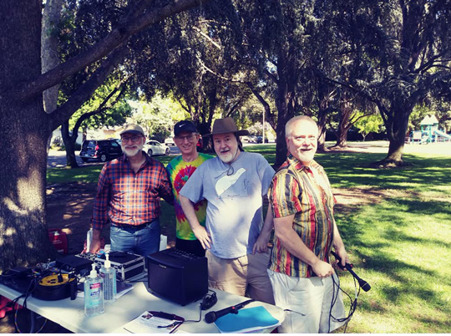
Thanks to our Club Callers…
Dave Decot
Kurt Gollhardt
Michael Levy
Mike Pogue
Rich Reel
James Thompson
Special thanks to Kurt for managing the club caller schedule and class communications

Slide 38
And special thanks to:
Eric Bier: Class review sessions
Carol Cook & Susan Grieger: Dance decorations
The Michaels, Eric Hudson: Theater outings
Eric Hudson: Club history project
Jenny Robertson: Pumpkin queen
Sheri Winkenwerder: Birthday cakes and general ECR den mother

Slide 39
Club History Project
We want to acknowledge long-term members with an anniversary bar to hang from your badge – 5, 10, 15 years…
If you haven’t done so already, please verify with Eric Hudson that your membership dates are accurately recorded.

Slide 40
2026 Longevity Awards
30 Years
Allan Hurst
20 Years
Gary Collins
Rick Trushel
15 Years
Kevin Dickmann
Jim Maxwell
Caren Stephens
Tim Stephens
10 Years
Michael Golden
Mike Keeley
Michael Levy
Stephanie Reyes
5 Years
Jeff Alder
Sabra Chartrand
Indra Ong
Ryan Robertson
Dawn Strahler
Notes:
CHECK WITH ERIC ON THIS

Slide 41
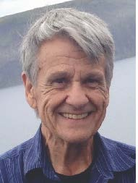
Mike Laster
Mike and Bonnie Laster joined ECR in 2023
Mike passed away in November 2025
Bonnie is holding a celebration of Mike’s life on Saturday Feb. 28. All ECR folks are invited. See email for details.

Slide 42
And many thanks to…
Everybody who brings food
Everybody who helps out at dances (decorations, 50-50 raffle, cleanup)
Everybody who attends Board meetings (just ask!)
The Election Committee and other volunteers
All our generous donors
… AND ALL OUR DANCERS!

Slide 43
ANY QUESTIONS?
A link to this slide set will be posted on www.reelers.org

Slide 44
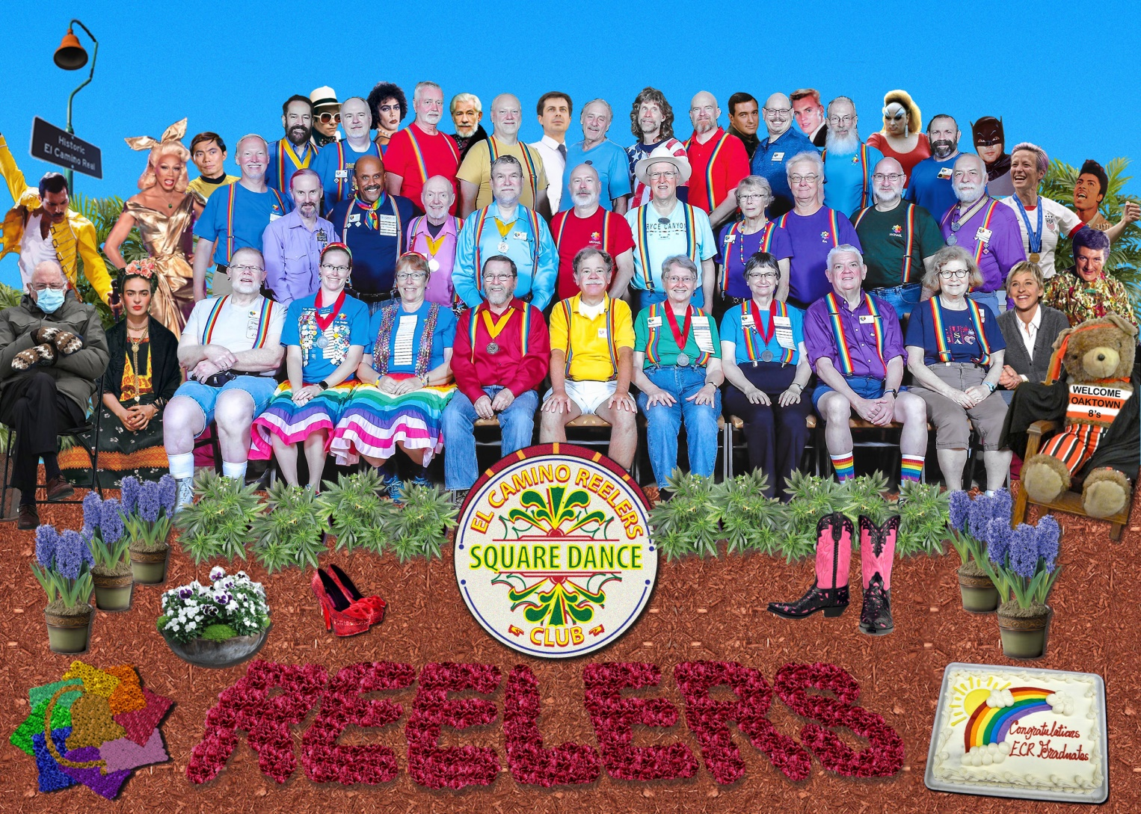
THAAAANK YOU!!
Now let’s dance!

